Slide 1
Parkwood Renovations:
Updating 1950’s Houses to Today’s Standards
master bedroom with luxury bath & walk-in closet
big, open concept kitchen & family room
garage
separate powder room
additional bedrooms

Slide 2
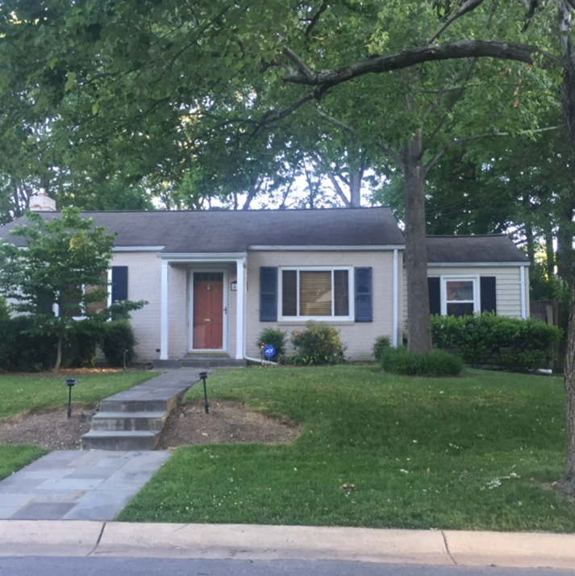
Dual front door

Slide 3
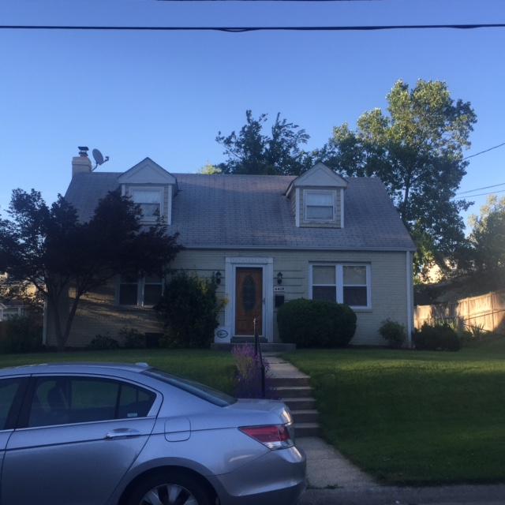
Dual front door

Slide 4
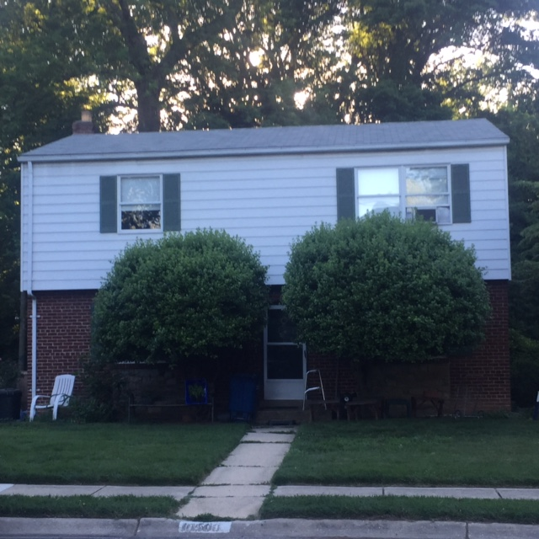
Dual front door

Slide 5
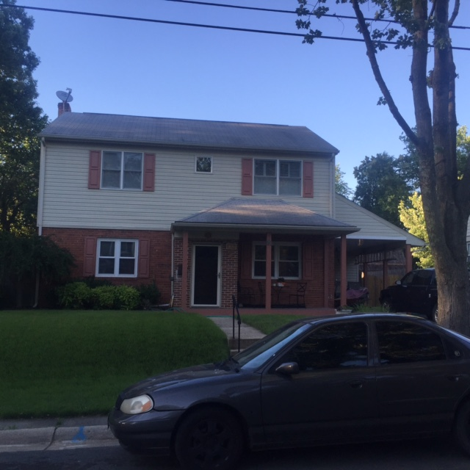
Dual front door

Slide 6
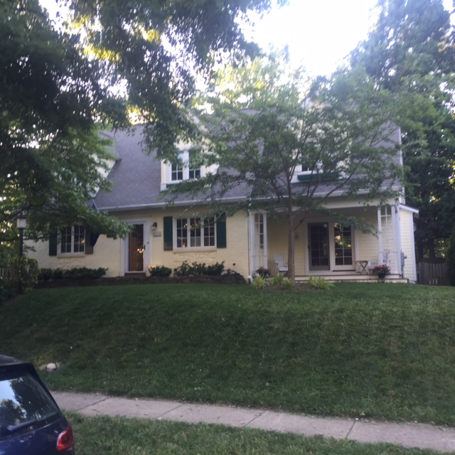
Dual front door

Slide 7
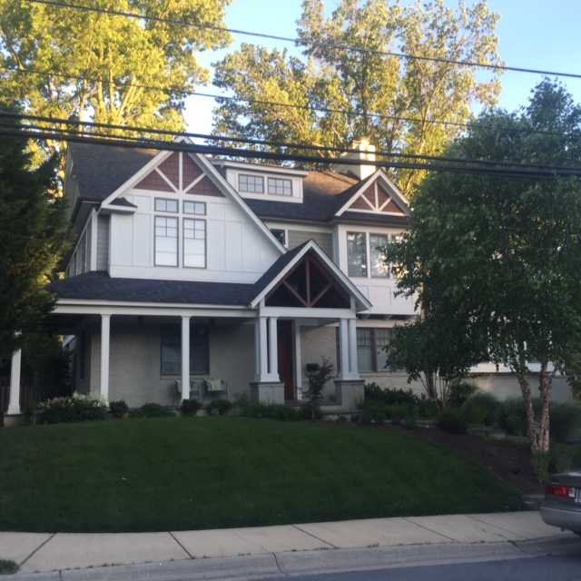
Dual front door

Slide 8
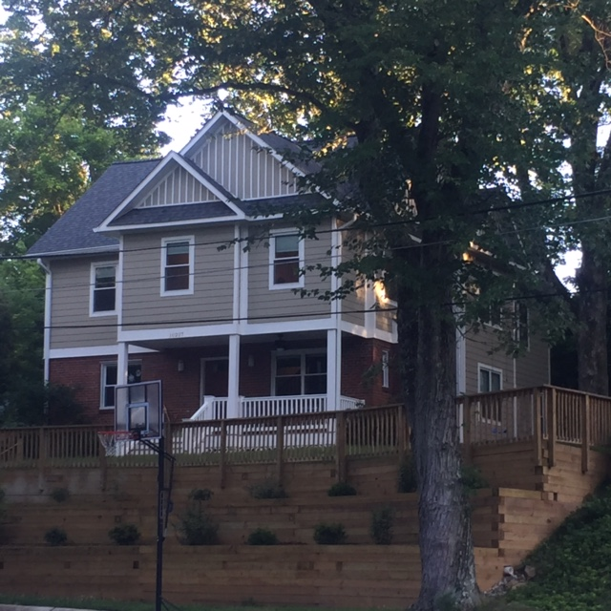
Dual front door

Slide 9
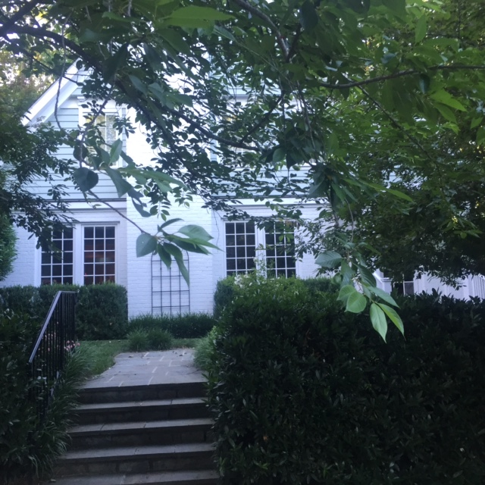
Dual front door with front chimney

Slide 10
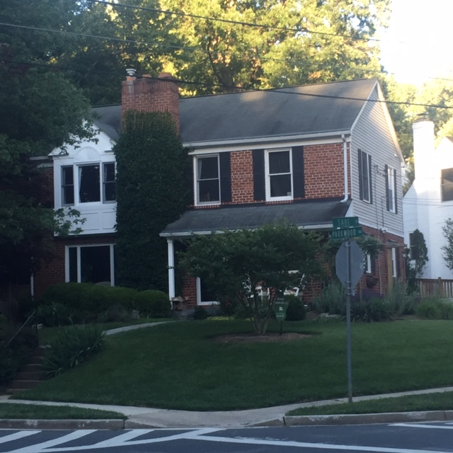
Dual front door with front chimney

Slide 11
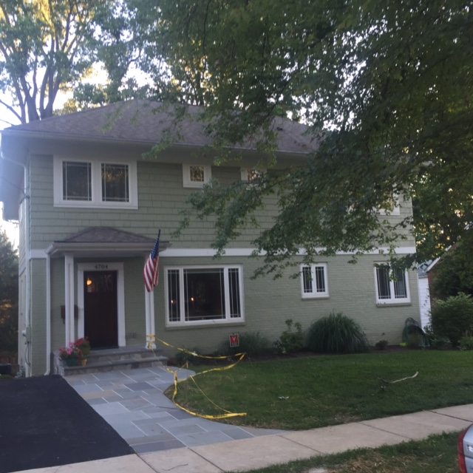
Front door on side, no offset

Slide 12
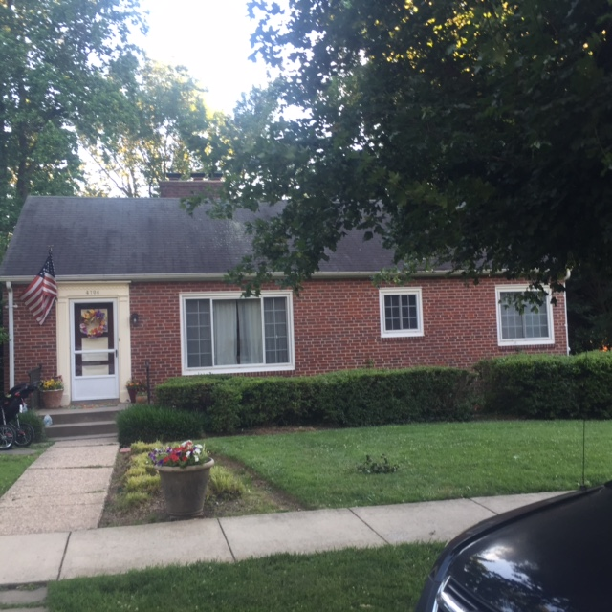
Front door on side, no offset

Slide 13
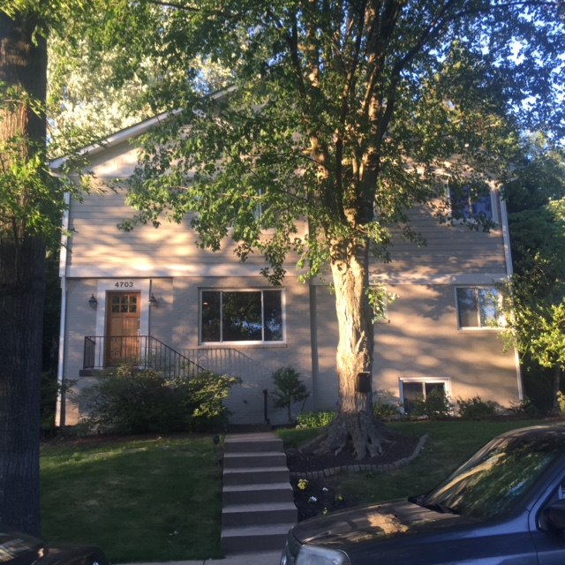
Front door on side, small offset
Front door on side, small offset

Slide 14
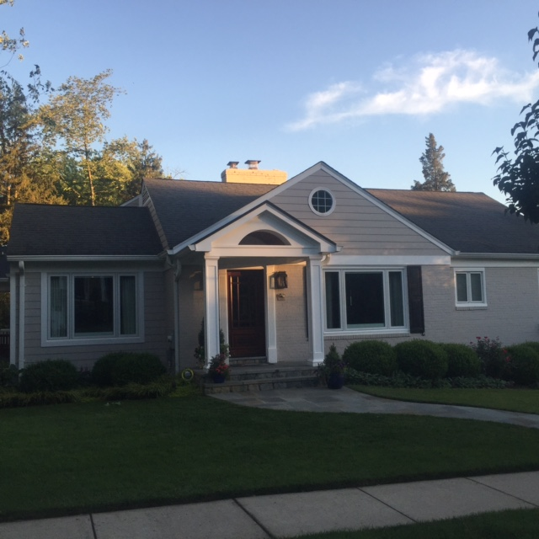
Front door on side, big offset

Slide 15
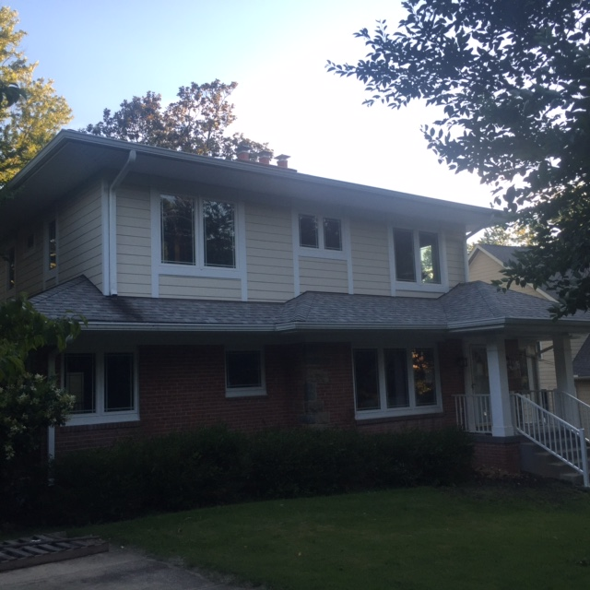
Front door on side, big offset

